Slide 1
Master Thesis
Images for Thesis and presentation

Slide 2

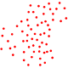
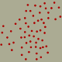
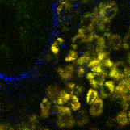
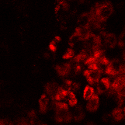
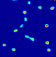
Napari
Point cloud
Labeling with points in 3D
Training data
Density maps for multiple cell classes
U-net
Stack
NADH
Cell Number
Threshold + Object counting

Slide 3


Stack
Simulator
Data
Napari
FIJI
or
Annotation
PointCloud.csv
PointCloud.roi
PointCloud
NADH
PointCloud
NADH Synthetic
Training data
U-net
U-net

Slide 4
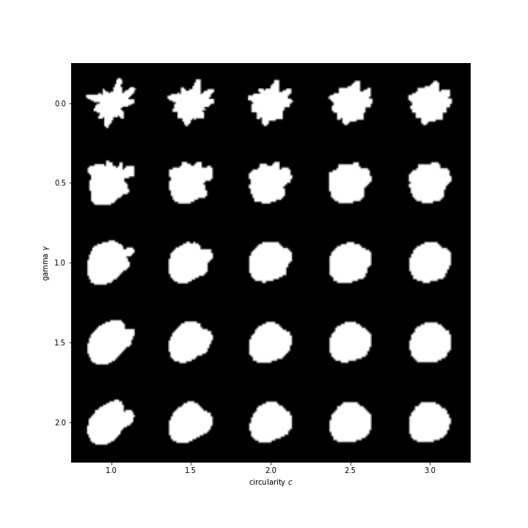
Shape generation with differrent parameters

Slide 5
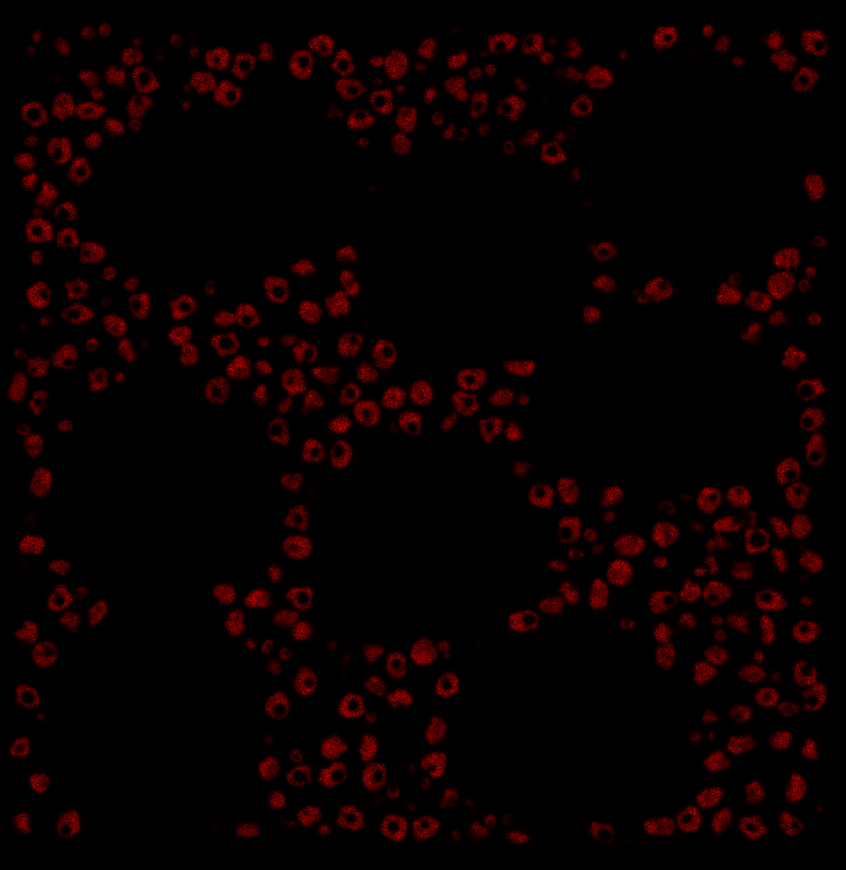
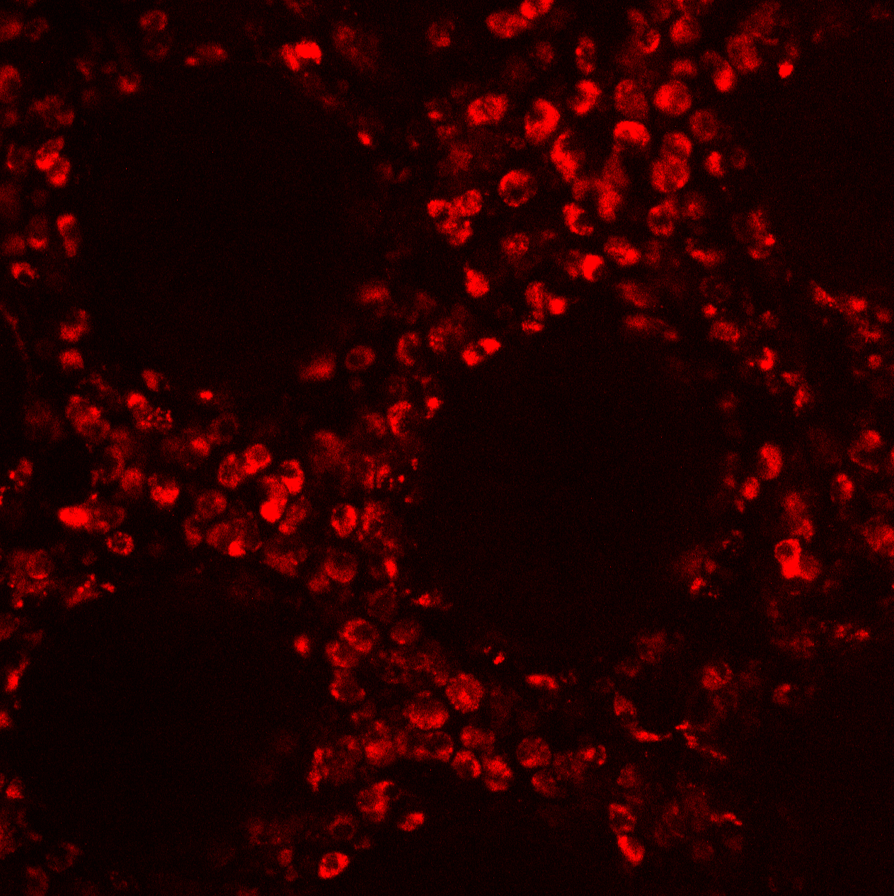
Guess where is the simulated image?

Slide 6
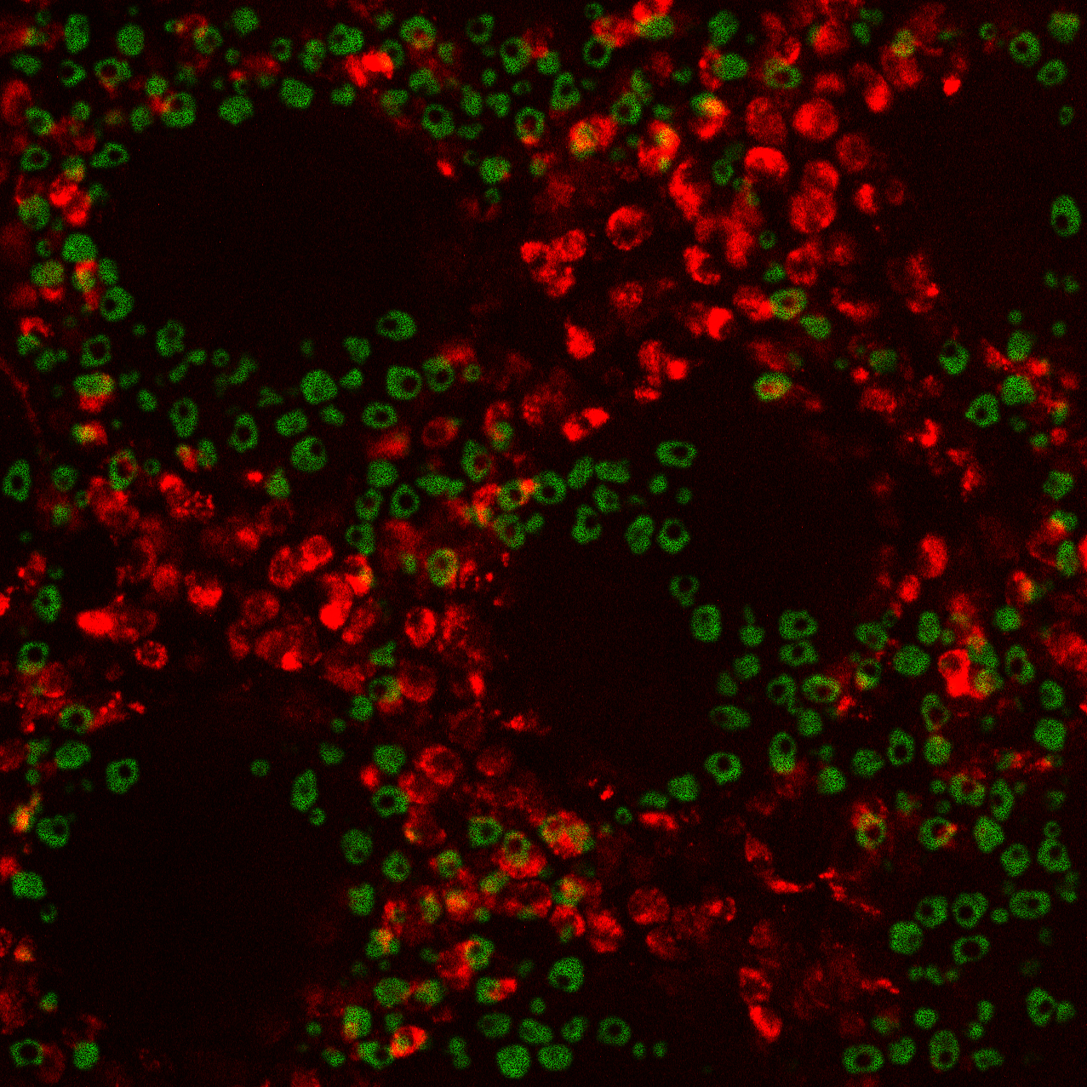

Slide 7
w₁₁
a₁
x₁
w₁₂
a₂
w₁₃
x₂
y₁
w₁₄
a₃
x₃
a₄

Slide 8
a₁
x₁
w₂₁
w₂₂
a₂
x₂
y₁
w₂₃
a₃
w₂₄
x₃
a₄

Slide 9
B.
A.
w₁₁
a₁
a₁
w₂₁
x₁
x₁
w₁₂
w₂₂
a₂
a₂
x₂
w₁₃
y₁
x₂
y₁
w₂₃
a₃
a₃
w₁₄
w₂₄
x₃
x₃
a₄
a₄
C.
A
X
a₁
x₁
a₂
Y
x₂
y₁
a₃
x₃
a₄

Slide 10
a₁
x₁
a₂
x₂
y₁
a₃
x₃
a₄

Slide 11
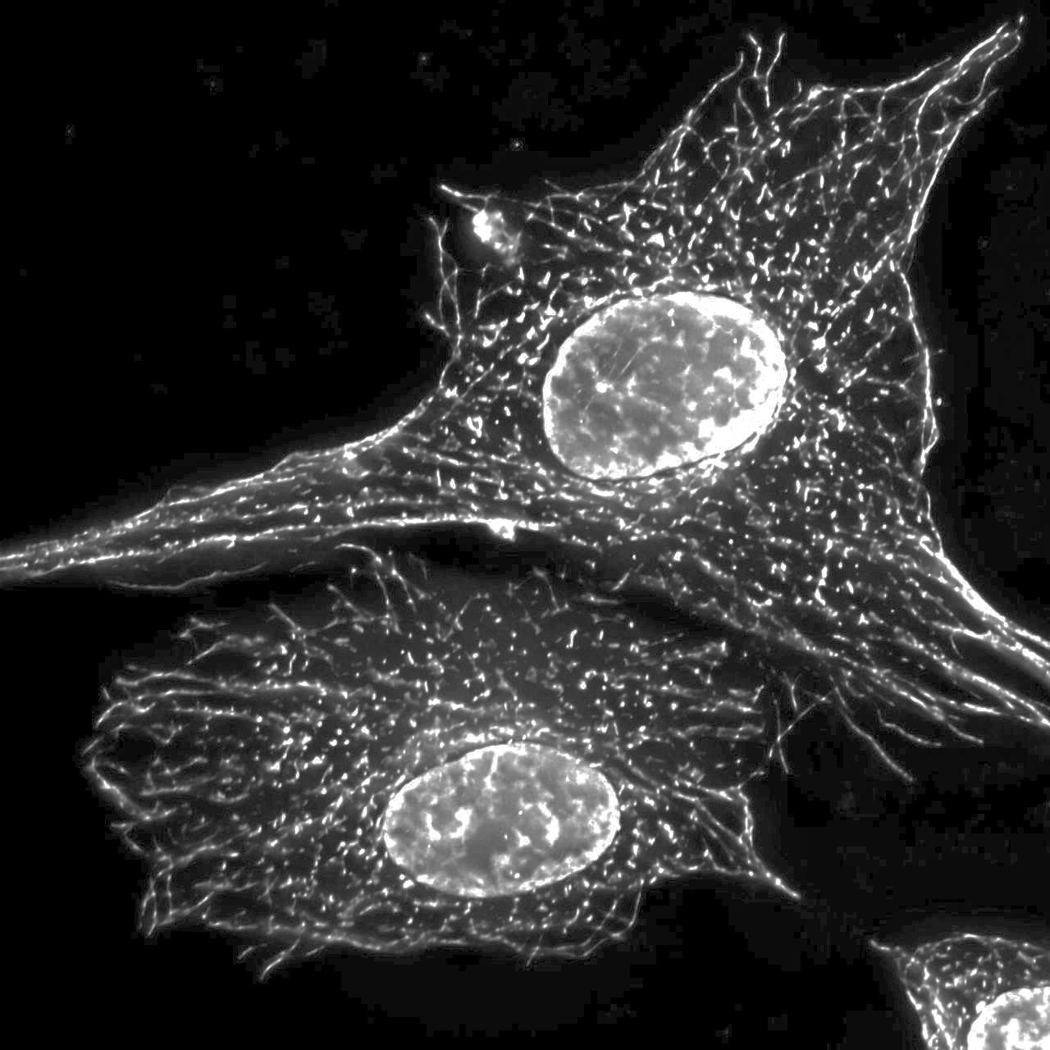
k₁
k₁
k₂
…
k₃
k₂
k₃
k₄

